Slide 1
M&E officer manual
Nov. 2023

Slide 2
HANWASH Planning
FY18
FY19
FY20
FY21
FY22
FY23
FY24
FY25
FY26
FY27
FY28
FY29
FY30
…
HANWASH Program
Program
Phase
Phase 1
(2018-2023)
Mattson
(2023-2028)
Next phase
(beyond 2028)
Commune
Cavaillon
Project
Cavaillon 1
Project
Cavaillon 2
Project
Cavaillon 3
Commune
Pignon
Commune
…

Slide 3
Integration with sector systems
SIEPA forms
Commune action plans
Projects
Activities
Implementation forms
SIEPA forms – DINEPA’s sector monitoring system which tells us the current situation.
Commune Action Plans – The Commune WASH Committee creates a plan for getting from the current situation to a desired situation.
Projects – HANWASH and other partners split up the Commune Action Plan into manageable chunks and generate projects.
Activities – Projects consist of many different activities.
Implementation forms – For each activity, the implementing partner will fill out multiple different data forms.

Slide 4
Project cycle
Each project has a the following set of phases:
Project Proposal
Implementing Partner Procurement
Implementation
Post Implementation
Finalized proposal
Signed contracts
Final report
Post Implementation Monitoring
Quarterly and Annual Reports

Slide 5
M&E Officer
Information System Related Roles
Microsoft Teams
Manage the authoritative copies of Program and Project monitoring frameworks (PMF)
Update the PMF documents according to mWater Implementation results
Submit reports on the implementation of projects
Ensure the correct file structure in Teams is respected
mWater
Perform quality assurance on the Implementation Data
Populate the Projects, Activities, Commune Action Plans, and Indicator tables
Work with implementing partners to review PMF quarterly
Ensure the correct file structure in mWater respected

Slide 6
Key tasks
Create a project and a corresponding PMF
Update the PMF project document
Send out list of CAP activities
Allocate Activities a project
Update the Activities table
Perform QA on the implementation monitoring
Perform QA on the project system
Manage the File structure in Microsoft Teams
Manage the File structure in mWater

Slide 7
Create a project
Description: Before a project is launched, its information must be added to the HANWASH systems
Frequency: Once, before the project starts
Result: The completed version of this document should be used as an annex to all projects signed for HANWASH Implementing Partners.
Storage location: In the project folder in HANWASH Microsoft share drive e.g. Cavaillon > Cavaillon 1. The final version should be labeled with the format "Project - PMF”, e.g.: "Cavaillon1 - PMF".
Step | Platform | Description
1 | Microsoft Teams | Create project in Microsoft Teams
2 | PMF Excel document | Duplicate and modify the PMF
3 | mWater | Add project folder to the HANWASH Documents
4 | mWater | Add a project to the projects table

Slide 8
1) Create project in Microsoft Teams
From the Microsoft Teams interface:
Make a copy of the Excel template titled "Project - PMF - Template".
Please name this using the format "<Project name> - <Implementing partner name> - PMF" e.g. Cavaillon 3 - HO - PMF

Slide 9
2) Duplicate and modify the PMF
Project LM sheet
Change the data in the header to match the project information
Project Overview
Highlight the cells with the objectives that the project will address in green
Write a short summary of the objectives of the project in the project overview. This should ideally be pulled directly from the project proposal, but if not it can be summarized from project documents.
Change the data in the header to match the project information
Highlight the indicators related to the project's objectives in green. Note: These should correspond to the objectives highlighted in step 3.
M&E Framework
Change the project name in column A for all the highlighted indicators to the project name e.g. <Cavaillon 3 - HO>
Filter the table via cell A13 to only show indicators applicable to this project
Use project documents to populate the End of Project Targets for each indicator. Note: Please add comments to the cells themselves and notes in the far right column as needed.
Modify the data headers to include one entry for each reporting period during the project e.g. Q1-2024,Q2-2024,Q3-2024,Q4-2024…
Schedule a meeting with the Implementing Partner to populate targets for each indicator and each quarter. Please put a "-" where there is not target for that period.

Slide 10
3) Add project folder to the HANWASH Documents
In mWater HANWASH Documents page:
go to HANWASH's Organizational documents: HANWASH > Programs > HANWASH. Add a folder for this project to store only core documents which will be shared with various partners e.g. PMF, Work Plan, Budget, etc.
Create a share link for this folder and copy it to your clipboard.

Slide 11
4) Add a project to the projects table
In the mWater HANWASH Projects table, add a row for the project by clicking the "+" icon. Fill in the core information.
Set the "Program name" field to "HANWASH”
Set the "Project name" to follow the format: <Commune> <Number> e.g. "Cavaillon 3”
Consult the Project documents to find project's ID and put it in the "Project ID" column. Many projects will be Global Grants, so please use the global grant number GG.....
Set the "Admins" field to "HANWASH -> Admins"
Set the "Viewers" field to "Public".
Set the "Funder" field to the name of the main funder of the project
Set the "Implementing partner" field to the name of the implementing partner. Note: A separate project should be created for EACH IMPLEMENTING PARTNER e.g. Cavaillon 1 - Haiti Outreach, Cavaillon 3 - Water Missions. This will allow us to track their accomplishments separately.
Set the "Project status" column to Planned, In-process, or Completed
Set the "Date started" field to the CONTRACTUAL date that the project was started
Set the "Date completed" field to the CONTRACTUAL date that the project was ended
In the "Amount budgeted" column, enter the CONTRACTUALLY BUDGETED AMOUNT
In the "Currency" field, typically set this to USD
In the "Project description field, write a short description of the project. It's best to pull this from project documents.
In the "Beneficiaries (projected)" field, enter the estimated number of beneficiaries
In the "Project admin region" field, please select the admin region where this project will be conducted. This will define which department or commune is displayed on maps.
In the "External project document folder" field, enter the HANWASH Microsfot Teams sharelink to the project document. This should not be public, but still be protected by user account sign-ins.
In the "mWater Project document folder" field, paste the share link from step 13.
In the "Funder logo" field, upload the logo of the funder
If the project is a HANWASH project, set "Aligned with core values" to "Yes". If the project is not managed by HANWASH, please ask the HANWASH CEO if it meets the necessary criteria for "Aligned with core values"

Slide 12
Update the PMF project document
Description: Every quarter the Project Monitoring Framework document bust be updated and a new version bust be saved.
Frequency: Quarterly for each project
Results: A new version of the PMF document must be sent to the HANWASH CEO and M&E Subcommittee
Storage location: In the project folder in HANWASH Microsoft share drive e.g. Cavaillon > Cavaillon 1. The updated version should be labeled by adding the reporting period to the end of the file name e.g. "…Cavaillon1-Q1-24".
mWater file storage: Once complete, this file should also be saved in HANWASH's mWater folder for the project. This will ensure that all stakeholders have access to the indicator results in a digestable manner.

Slide 13
Update the PMF document
mWater HANWASH - M&E Team console
At the end of each reporting period, you must populate the "Actual" results for each indicator. Start by going to the mWater Console "HANWASH - M&E Team" and opening the "Indicators" tab.
Use the dropdown menu to filter the page to the appropriate project e.g. "Cavaillon 3 - HO”
It's critical that this data is correct, so if anything seems out of the ordinary, please fix it in mWater before copying to the excel sheet here.
M&E Framework sheet of the project’s PMF document
Duplicate the PMF document
For each indicator, copy the value from mWater and paste it into the M&E framework "Actual" result
Meet with implementing partner
Schedule a meeting with the Implementing Partner and send them the updated version of the PMF
The objectives of this meeting will be to:
Validate the accuracy of the data
Add notes/ explanations for each of the “Target” which did not achieve its “Actual” value
Email
Send the finalized version of this document to the HANWASH CEO and M&E Subcommittee

Slide 14
Send out list of CAP activities
Description: In this process, you will print those activities remaining in a commune and distribute it to the Implementing Partner.
Frequency: Once, at the beginning of the project
Followup: The Implementing partner must then work with the Commune Committee to choose which activities will be a part of this project. The activities chosen should correspond to the implementing partners’ contractual obligations, e.g. 13 new boreholes, 2 rehabilitated piped water systems, 3 school WASH, etc.

Slide 15
Steps
Commune action plan > Project Activities Assignments:
Filter the page to the appropriate Commune where the project will take place.
Filter the Project to "No Project Assigned".
Export and print the Activities List and send this to the Implementing Partner.
Note: The WASH Focus, Category, and Technology of the activities should match that required by the contract.

Slide 16
Allocate Activities a project
Description: In this process, you will allocate a set of activities from the Commune Action Plan to a project, based on those chosen by the Implementing Partner and Commune Committee.
Frequency: Once, after the Implementing Partner and Commune Committee have chosen the exact activities that will be a part of the project.

Slide 17
Steps
Go to the page HANWASH – Commune Action Plan > Project Activities Assignment.
a) Filter this page to a specific commune
c) Go to the section “Allocate activities to a project”
d) For each item selected in the printed list, choose the corresponding activity form the table at left:
Click the activity on the left
Edit the response
Change the Program and Project
Change the Implementation Status to “In-process”
Click "Submit"

Slide 18
Update the activities table
Description: In this process, you will update the Activities table based on the results reported by implementing partners. This will be the final indicator results shared with DINEPA, Local Authorities, and sector stakeholders to display the results of each project and how they have contributed to the Commune Action Plan.
This will include:
Allocating sites to an activity
Updating the Implementation status
Filling in the Start and End dates
Adding the activity results
Frequency: Quarterly, after the implementing partner has submitted their report

Slide 19
Steps
Go to the page HANWASH – Commune Action Plan > Project Activities Assignment.
a) Filter the Page to a specific commune
b) Filter the table at right to a specific project
c) Go to the section “Update the activities table”
d) For each item on the right, choose the corresponding activity:
Click the activity on the left
Edit the response
Change the Program and Project so that it corresponds to the implementation data (at right)
Change the Implementation status so that it corresponds to the implementation data (at right)
For those sites which have been inaugurated, please add the results so that they correspond to the implementation data (at right)
In the Settings section, select the site which corresponds to the implementation data (at right)

Slide 20
Add new activities to the commune action plan
Description: The commune Action Plan serves as a guide for WASH investments in a commune, but must be adapted to new information and local priorities. This process can be used whenever the Commune Committee decides to add activities to their commune action plan.
Frequency: On initial Commune Action Plan creation AND whenever the Commune Committee decides to update their plan
Note: This process will most likely be done by the Implementing partners in the field, in close collaboration with the Commune Committee.

Slide 21
Steps
To add an activity to a commune action plan:
Go to the app.mwater.co in the browser or on a mobile device.
Add the core information
Use the GPS to set an estimated point for where the activity will take place. This is ideally done in the field by the implementing partner.
Add the corresponding “Commune Action Plan” and “Program & Project”
Set “Implementation status” to “In-process”
Add the planned Results e.g.:
Indicator group: ”Mattson”
Indicator name: “# of people added with basic drinking water survey”
Planned value: “Add the estimated number of people in the community”.
If the Site has already been created, use the “Setting” information to link to the existing site. If not, this can be left for later
Submit the form

Slide 22
Perform Quality assurance on implementation monitoring
Description: This process seeks to ensure the high quality of HANWASH implementing partner data.
Since the implementing partner is the one who collects the data, this task requires working with them to fill in any gaps and address any errors.
Frequency:
Monthly check data quality and send email
Quarterly meeting with impelmenting partner

Slide 24
Perform Quality assurance on Project data

Slide 25
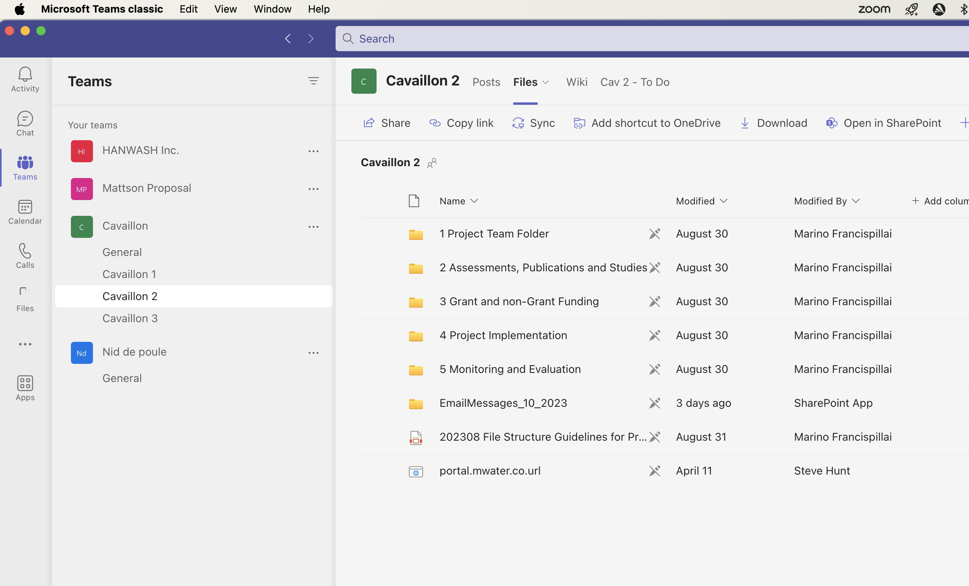
Manage the project File structure in Microsoft Teams
The Microsoft Teams file system allows for document management for internal HANWASH stakeholders.
The HANWASH file system is structured as different “Channels”, which are managed independently to allow for complex permission setting.
Each channel has the same file structure, shown at right. These are created by the HANWASH CEO.
Each project is listed as a folder within the associated commune. They contain:
Project Team Folder
Assessments, Publications, and Studies
Grant and Non-grand funding
Project Implementation
Monitoring and Evaluation

Slide 26
File structure - continued
There are several standard documents that must be present for each project, as shown in the table below.
Document | Frequency | Includes | Subfolder within project folder
Proposal | Once finalized | Work plan, budget, PMF* | Grant and non-Grant Funding
Contract | On signature | Work plan, budget, PMF | Project Implementation
Log Frame | Annually | Work plan, budget, PMF | Monitoring and Evaluation > 3 Reports
Annual and final report | Once finalized | Work plan, budget, PMF | Monitoring and Evaluation > 3 Reports
Other | Once finalized | Technical plans, studies, management agreements, etc | 2 Assessments, Publications, and Studies

Slide 27
Manage the File structure in mWater
The mWater Documents feature should be used to communicate core project documents to external stakeholders.
Document | Frequency | Includes
Project proposal | Once finalized | Work plan, budget, PMF
Contracts | Once finalized | Work plan, budget, PMF
Annual reports | Annually | Work plan, budget, PMF
Final report | Once finalized | Work plan, budget, PMF
Other | Once finalized | Technical plans, studies, management agreements, etc

Slide 28
Resources
System information
mWater Database - Overview - Provides a high level description of the system
Design specifications - Goes through the structure of the database, its data visualizations, and the tasks of each stakeholder
Implementation monitoring
Indicators - Visualize multiple projects, core data, and their results
QA - Used to clean up data coming from implementing partners
Project tracking
Tables - Used to modify project, activity, commune action plan, and indicator tables
Data checks - Used to ensure the correct configuration of project tracking data
mWater Project folder - Used to communicate core documents to external stakeholders
Teams
Impact pathway, Logframe, Theory of Change - The folder used for core M&E templates

